Slide 1



Effects of Gurney Flaps on Annular Wings
Presented By: Cherie Gambino & Juan Gutierrez
Mentor: Dr. Lance Traub
Professor
at Embry-Riddle Aeronautical University

Slide 2
Overview
Introduction
Research Process
Results
Future Directions

Slide 3
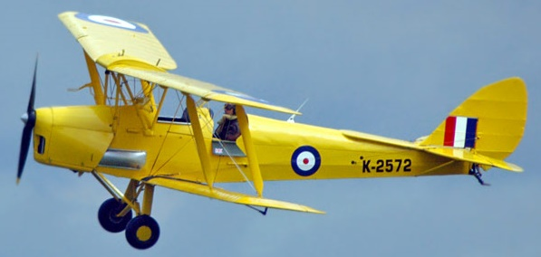

Introduction
Staggered Bi-plane Wing:
Stacked wing configuration
Horizontal forward or backward shift
De Havilland DH82a Tiger Moth Trainer Aircraft (www.airpowerworld.info)
Beech D-17S Staggerwing (www.vintagewings.ca)

Slide 4
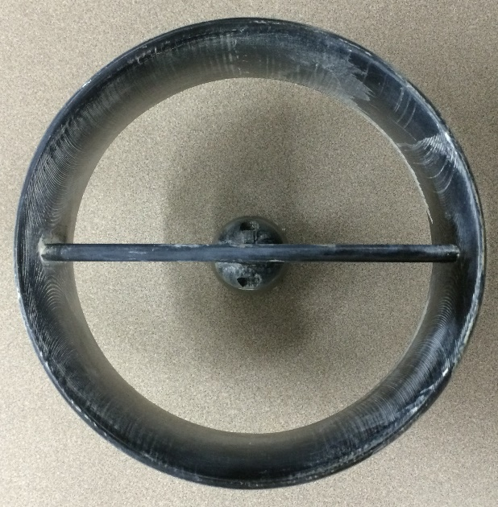
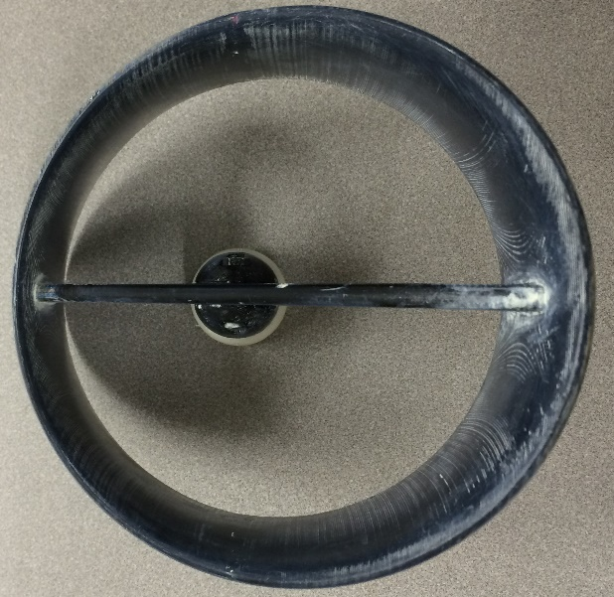
Introduction (Continued)
Staggered Annular Wing:
Circular closed wing
Sheared forward or backward
Non-staggered
Staggered
Model(s) built by Crawford and Lopez

Slide 5
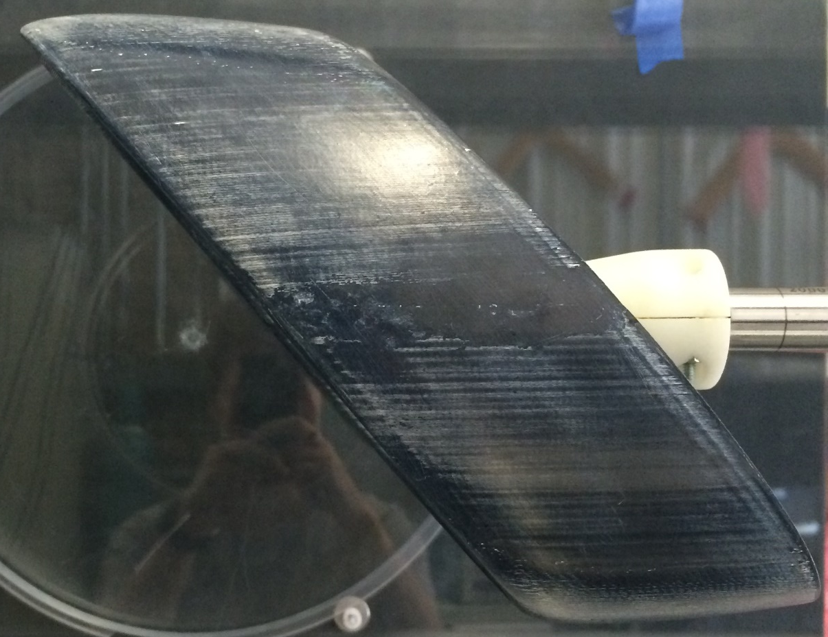
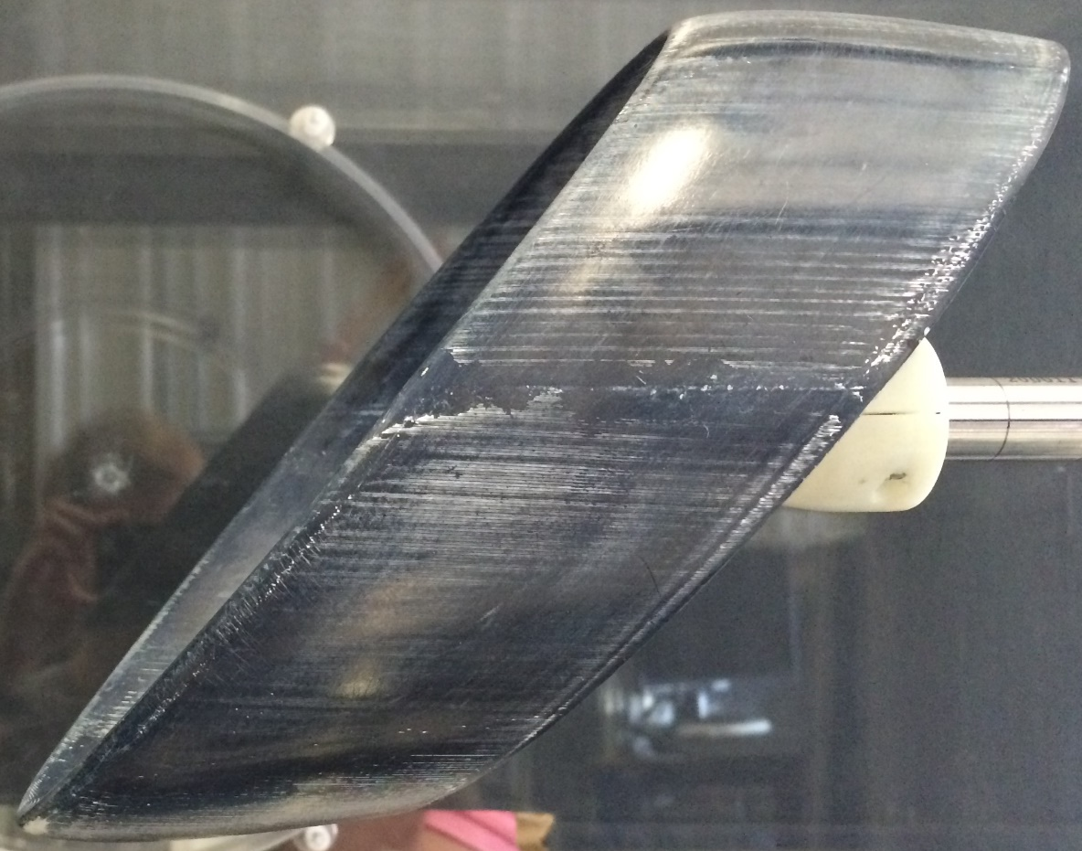
Introduction (Continued)
40° (forward stagger)
- 40° (backward stagger)

Slide 6
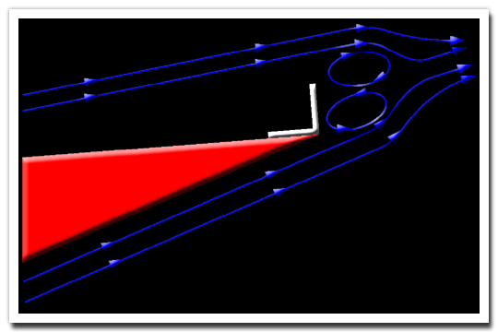
Introduction (Continued)
Gurney Flap:
Attachment to the pressure side an of airfoil’s trailing edge
Increases lift by interrupting the Von Karman Vortex shedding street
Causes lift increase because of pressure differential at TE caused by vortex street
http://www.allamericanracers.com/gurney_flap.html

Slide 7
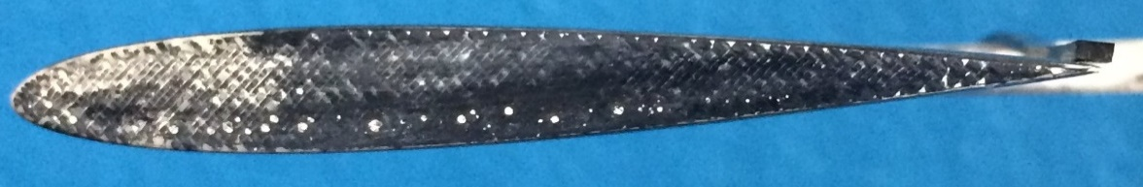
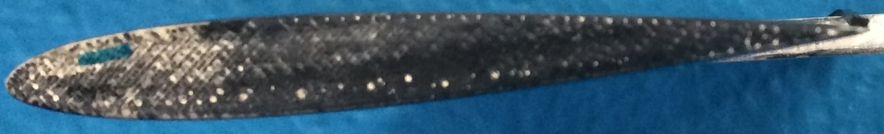
Research Process
Gurney flap width investigation
NACA 0012 Flat Wing (Chord of 3 in)
Widths of 1/50 in (0.5 mm) & 2/25 in (2 mm)
Adhesive rubber used for gurney flaps
Results:
Flap width negligible
Flap Width 2 mm
Flap Width 0.5 mm

Slide 8
Research Process
in
h=1/32 in
W = 1/50 in
W = 2/25 in
Clean Wing

Slide 9
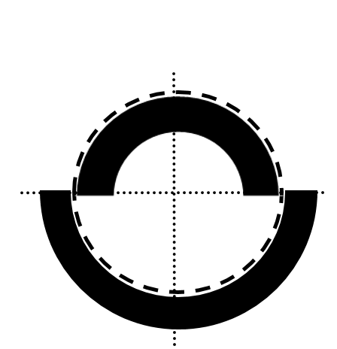
Results
Looking into the flow
depiction
For -40° (backward stagger)
For 0° (no stagger)
For 40° (forward stagger)
Flaps
Annular Wing

Slide 10
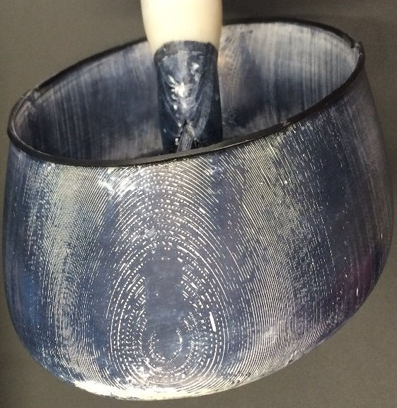
Results Cont.
2 mm wide Gurney Flaps

Slide 11
Results
For -40° (h/c = 0.0208, h = 1/16 in)
Largest C_{L} increase
Poor performance near stall angle in C_{m} & C_{L}
Highest C_{D}
For -40° (h/c = 0.0104, h = 1/32 in)
Lower C_{L} increase but still improved compared to clean wing
Poor performance near stall angle in C_{m}
Lower C_{D} at high angles of attack
Flow

Slide 12
Results

Slide 13
Results
For 0° (h/c = 0.0208, h = 1/16 in)
Large increase in C_{L} and good stall behavior
Good overall performance in C_{m} no large pitch break
No increase in C_{D}
For 0° (h/c = 0.0104, h = 1/32 in)
Still has large increase in C_{L}
No large pitch break
No increase in C_{D}
Flow

Slide 14
Results

Slide 15
Results
For 40° (h/c = 0.0208, h = 1/16 in)
Small increase in C_{L} and poor stall behavior
Non-linear pitch behavior
No increase in C_{D}
For 40° (h/c = 0.0104, h = 1/32 in)
Small increase in C_{L} and poor stall
Pitch behavior is also non-linear
No increase in C_{D}
Flow

Slide 16
Results

Slide 17
Future Directions
Additional tests at higher Reynolds numbers
Flow Visualization
Documentation and publication

Slide 18
Summary
Introduction
Research Process
Results
Impact

Slide 19
Thank you!
Special thanks to Dr. Lance Traub our mentor and Dr. Gary Yale our manager

Slide 20
Results Summary (Backup)
Degree of Stagger | CL 1/16 | CL 1/32 | Cm 1/16 | Cm 1/32 | CD 1/16 | CD 1/32
-40 | Large increase | Low increase | Poor stall | Poor stall | Lower at high angles | Higher at high angles
0 | Large increase | Large increase | No pitch break | No pitch break | No increase | No increase
40 | Small increase & poor stall | Small increase & poor stall | Non-linear behavior | Non-linear behavior | No increase | No increase

